Slide 1
Machine Learning - Supplier Audit Data Clustering & Supply Chain Optimization
陳逸 Rachel Chen

Slide 2
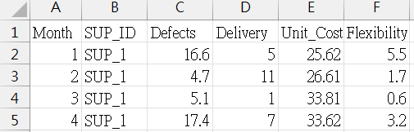
Dataset
Supplier Audit Data
Dataset Description
This dataset captures monthly performance metrics for suppliers. Each row represents the audit results for a specific supplier in a given month.
Size: 1,801 rows / 6 columns
Breakdown of the Columns
Month: Represents the month in which the audit data was collected.
SUP_ID: A unique identifier for each supplier.
Defects: The percentage or count of defective items reported during the audit.
Delivery: The delivery performance score, where a higher score indicates better delivery reliability.
Unit_Cost: The average cost per unit supplied by the supplier (in monetary terms).
Flexibility: A rating of the supplier's ability to adapt to changes in demand or specifications.

Slide 3
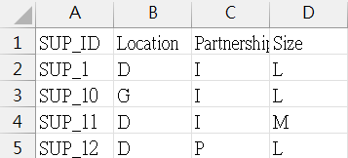
Dataset
Supplier Characteristics
Dataset Description
This dataset provides detailed background information on suppliers to complement the audit data.
Size: 27 rows / 4 columns
Breakdown of the Columns
SUP_ID: A unique identifier for each supplier, corresponding to the Supplier Audit Data.
Location: The geographical location of the supplier, represented by a code.
Partnership: The type of partnership with the supplier (e.g., "I" for internal or "P" for partner).
Size: The size of the supplier's operation, represented by a code.

Slide 4
About
【Purpose】 Identify supplier performance patterns using unsupervised analysis and apply linear programming to optimize the supply chain.
【Data Processing】
Identify Supplier Performance
Unsupervised Learning (K-means)
Linking Clusters to Supplier Characteristics
Linear Programming for Supply Chain Optimization
Solve using PuLP for optimal solutions
Provide recommendations
Notes:
Log: The actual_productivity values likely range between 0 and 1 (as percentages). Taking the logarithm can help reduce skewness and make the distribution more symmetric, which is often a prerequisite for statistical analysis or modeling. 取對數有助於減少偏度 更加均勻分布 (看之前sca得作業說明可能會更懂:Therefore, when data is transformed into logarithmic scale, it tends to become more evenly distributed compared to its original scale.，power bi 圖片也有取對數，bar chart看起來會更均勻分布，減少異常值，極端值)

Slide 5
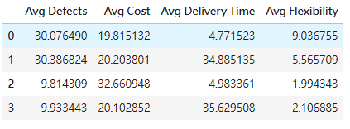
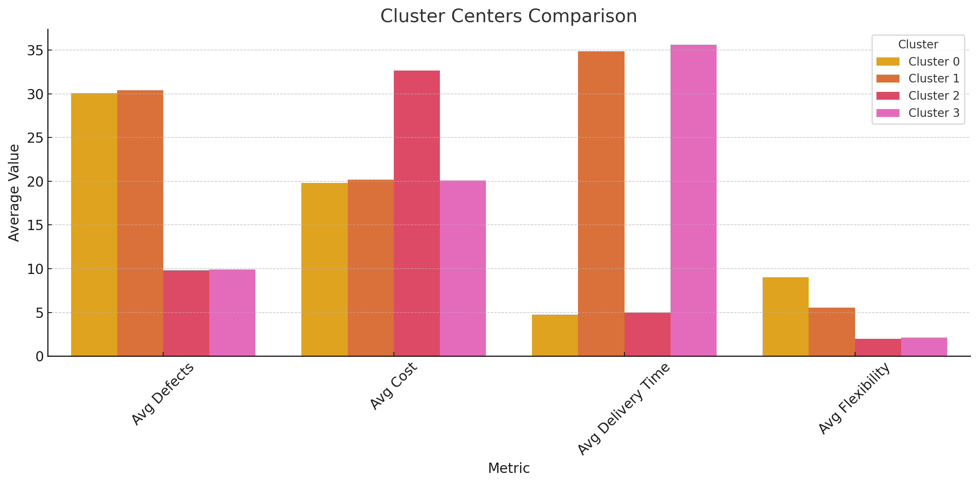
Unsupervised Learning - K-means Cluster Centers
Clustering Data
- Defects, Unit Cost, Delivery, Flexibility
Creating the K-Means Model
- Configured with 4 clusters.
Extracting Cluster Centers
Cluster | Key Traits
0 | High defects, flexible, fast delivery
1 | High defects, slow delivery
2 | Low defects, fast delivery, costly
3 | Low defects, slow delivery, inflexible

Slide 6
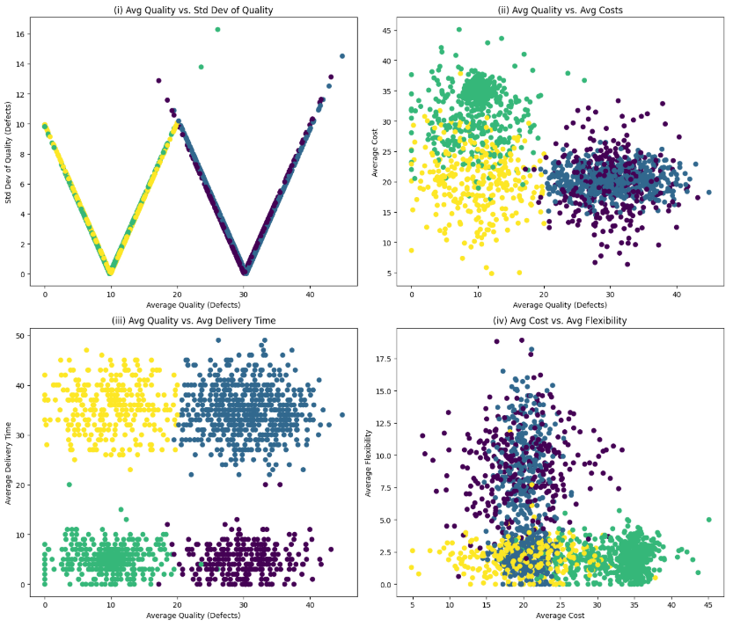
Unsupervised Learning – K-means Clustering Insights
Avg Quality vs. Std Dev Quality
The middle range of defects has a larger standard deviation, indicating more instability in quality.
Avg Quality vs. Avg Costs
Cluster 0 (purple), with high cost and high defects, indicates potential production control issues or resource waste.
Avg Quality vs. Avg Delivery Time
Cluster 1 (blue) has long delivery and high defects suggest supply chain improvements.
Cluster 0 (purple) has short delivery but defects are high, better quality control is needed.
Avg Cost vs. Avg Flexibility
There is no significant relationship between cost and flexibility.
Purple = Cluster 0, Blue = Cluster 1, Yellow = Cluster 2, Green = Cluster 3

Slide 7
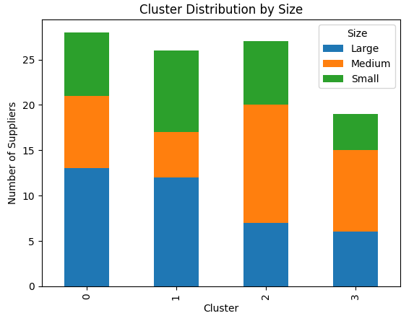
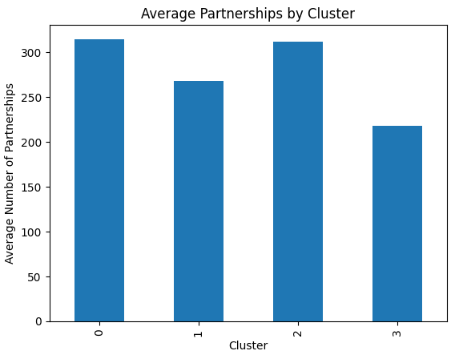
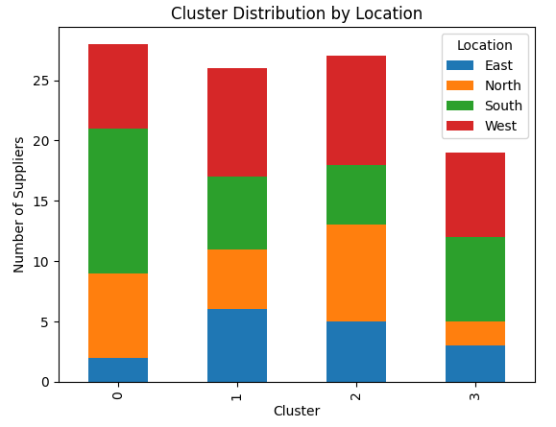
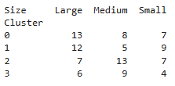

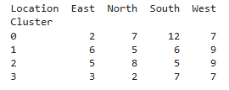
Linking Clusters to Supplier Characteristics
Clusters against Size
Clusters against Partnerships
Clusters against Location
Size:
Clusters 0 and 1 have more large suppliers, while Cluster 3 has the most small suppliers.
Partnerships:
Clusters 0 and 2 have strong partnerships, but Cluster 3 has the least.
Location:
Clusters 1 and 2 are well-distributed. Cluster 0 is concentrated in the South with less presence in the East, while Cluster 3 is limited in the East and North.

Slide 8
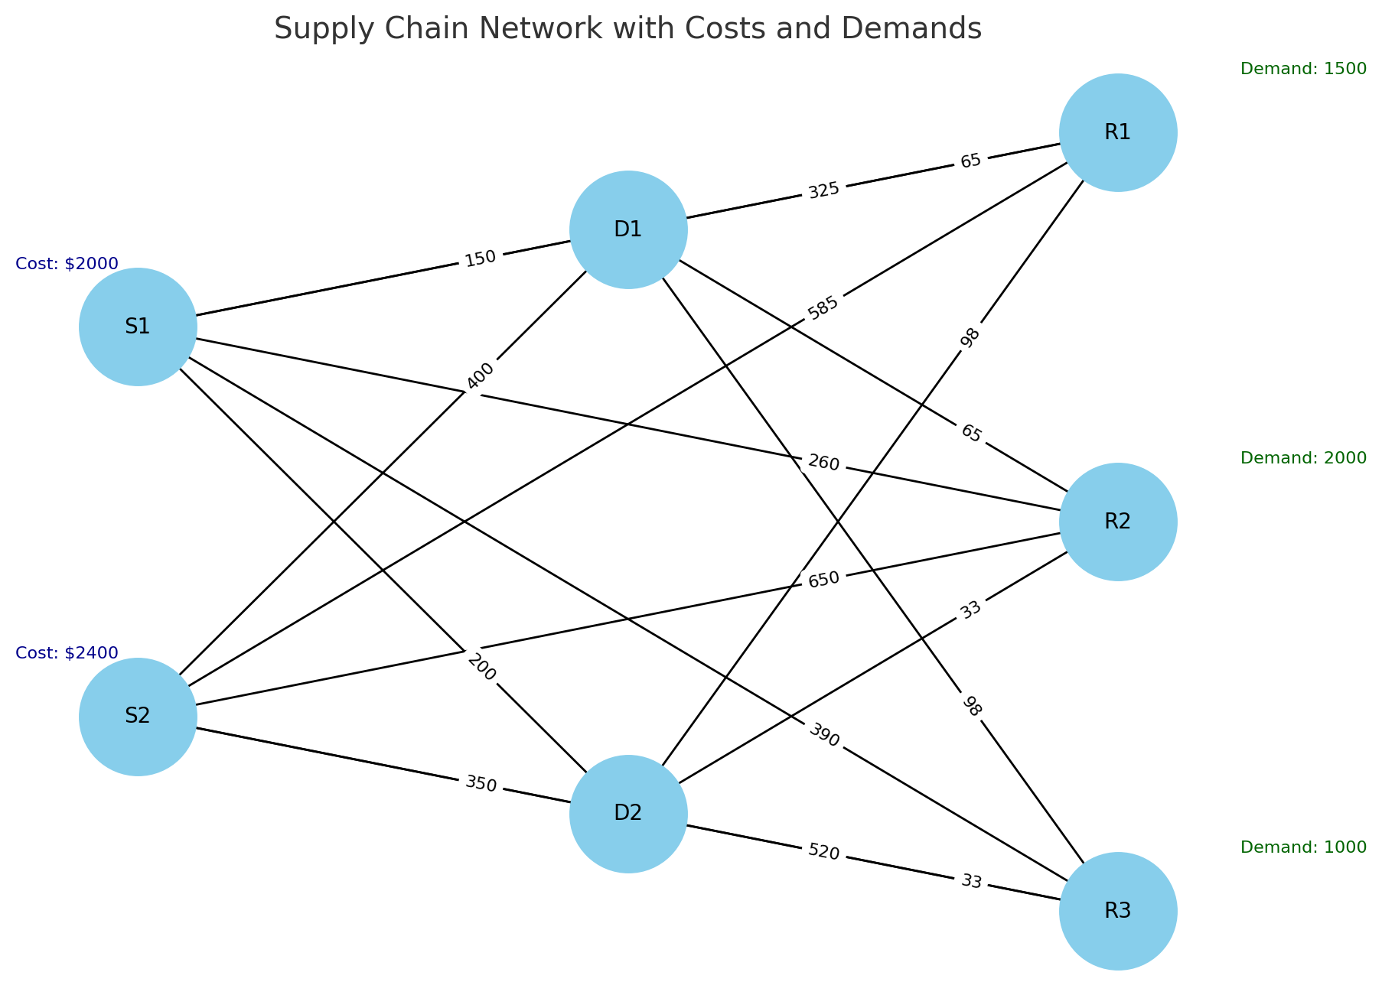
Optimizing Total Supply Chain Cost with Pulp
import pulp # Define the problem
prob = pulp.LpProblem("Minimize_Total_Cost", pulp.LpMinimize)
# Define manufacturing costs for each source
manufacturing_cost_S1 = 2000 # Manufacturing cost per unit at S1
manufacturing_cost_S2 = 2400 # Manufacturing cost per unit at S2
# Define transportation costs
transportation_cost = {
('S1', 'D1'): 150, ('S1', 'D2'): 200, ('S1', 'R1'): 325, ('S1', 'R2'): 260,
('S1', 'R3'): 390, ('S2', 'D1'): 400, ('S2', 'D2'): 350, ('S2', 'R1'): 585,
('S2', 'R2'): 650, ('S2', 'R3'): 520, ('D1', 'R1'): 65, ('D1', 'R2'): 65,
('D1', 'R3'): 98, ('D2', 'R1'): 98, ('D2', 'R2'): 33, ('D2', 'R3'): 33
}
# Decision variables for the quantity transported from source to destination
x = pulp.LpVariable.dicts(
"x", [("S1", "D1"), ("S1", "D2"), ("S1", "R1"), ("S1", "R2"), ("S1", "R3"),
("S2", "D1"), ("S2", "D2"), ("S2", "R1"), ("S2", "R2"), ("S2", "R3")],
lowBound=0, cat=pulp.LpContinuous )
# Objective function: minimize total manufacturing + transportation cost
total_manufacturing_cost = (
manufacturing_cost_S1 * pulp.lpSum(x[('S1', dest)] for dest in ['R1', 'R2', 'R3’]) +
manufacturing_cost_S2 * pulp.lpSum(x[('S2', dest)] for dest in ['R1', 'R2', 'R3’])
)
total_transportation_cost = (
sum(
x[origin, destination] * transportation_cost[(origin, destination)] for origin, destination in x )
)
prob += total_manufacturing_cost + total_transportation_cost, "Total Cost"
# Constraints: Demand and Supply # Demand constraints to ensure minimum demand is met at various nodes
prob += pulp.lpSum(x[('S1', 'R1')]) + pulp.lpSum(x[('S2', 'R1')]) >= 1500, "Demand_R1"
prob += pulp.lpSum(x[('S1', 'R2')]) + pulp.lpSum(x[('S2', 'R2')]) >= 2000, "Demand_R2"
prob += pulp.lpSum(x[('S1', 'R3')]) + pulp.lpSum(x[('S2', 'R3')]) >= 1000, "Demand_R3"
# Solve the problem
prob.solve()
Given conditions: Manufacturing, transportation costs, demand
Process
Define the problem: Minimize the total costs.
Specify the manufacturing and transportation costs.
Define the decision variables.
Set up the objective function.
Add constraints to meet the demand at each destination.
Find the optimal solution.

Slide 9
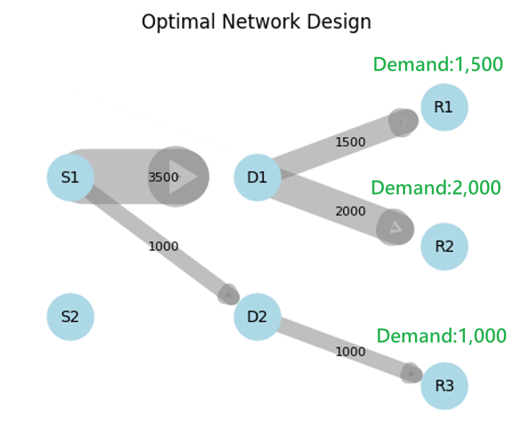
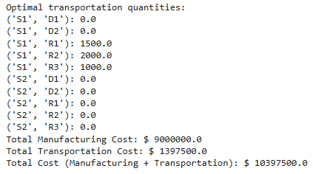
Optimizing Total Supply Chain Cost with Pulp
The Pulp analysis minimizes costs while meeting the demands of 1500, 2000, and 1000.

